Slide 1

Machine learning with python
Internship Association-
Antrix Academy
Regression on Auto mpg dataset

Slide 2

Submitted by:
Submitted To:
Ayush Jain
2010051
Cse-1
2000270100058
MR. Vishal Choudhary

Slide 3
Acknowledgement
I would like to express my special thanks of gratitude to my teacher Mr. Vishal Choudhary as well as our internship mentor Sir Shobhit Tyagi who gave me the golden opportunity to do this wonderful project on Machine Learning with Python, which also helped me in doing a lot of Research and I came to know about so many new things I am really thankful to them.
Secondly I would also like to thank my parents and friends who helped me a lot in finalizing this project within the limited time frame.

Slide 4
contents
Python
Advantages
Machine Learning and Python
What is Machine Learning
Types of Machine Learning
Supervised Learning
Product SWOT Analysis
Regression
Types
Libraries used
My Project
My Code
What it does.
Conclusion

Slide 5
Python…
Python is a popular programming language. Python is an interpreted high-level general-purpose programming language. Its design philosophy emphasizes code readability with its use of significant indentation. Its language constructs as well as its object-oriented approach aim to help programmers write clear, logical code for small and large-scale projects.

Slide 6
Python…
Advantages
Readable and Maintainable Code
Interpreted Language
Compatible with Major Platforms and Systems
Robust Standard Library
Free and Open-Source

Slide 7

Machine Learning and Python
Python offers concise and readable code.
Complex algorithms and versatile workflows stand behind machine learning and AI, Python’s simplicity allows developers to write reliable systems.
Developers get to put all their effort into solving an ML problem instead of focusing on the technical nuances of the language.
Python is appealing to many developers as it’s easy to learn.

Slide 8
Machine learning
Machine learning is the science of getting computers to act without being explicitly programmed. In the past decade, machine learning has given us self-driving cars, practical speech recognition, effective web search, and a vastly improved understanding of the human genome. Machine learning is so pervasive today that you probably use it dozens of times a day without knowing it.

Slide 9
Types of Machine Learning
SUPERVISED LEARNING
UNSUPERVISED LEARNING
Supervised learning is a machine learning approach that’s defined by its use of labeled datasets.
Supervised learning can be separated into two types of problems when data mining: classification and regression.
Unsupervised learning uses machine learning algorithms to analyze and cluster unlabeled data sets.
Unsupervised learning models are used for three main tasks: clustering, association and dimensionality reduction.

Slide 10
Machine learning- Supervised Learning
Classification :- Classification problems use an algorithm to accurately assign test data into specific categories, such as separating apples from oranges.
Regression :- Regression is another type of supervised learning method that uses an algorithm to understand the relationship between dependent and independent variables.

Slide 11
SWOT Analysis of Machine learning
S
STRENGTHS
Computing without coding- train it, not program it!
W
WEAKNESSES
Quality of data is every thing. Lacks humanity.
O
T
OPPORTUNITIES
Creating new high tech projects and startups just by using the power of ML
THREATS
Unintended consequences like people losing jobs

Slide 12
Regression
Regression is a supervised machine learning model.
Regression in machine learning consists of mathematical methods that allow data scientists to predict a continuous outcome (y) based on the value of one or more predictor variables (x). Linear regression is probably the most popular form of regression analysis because of its ease-of-use in predicting and forecasting.
Regression models are helpful for predicting numerical values based on different data points, such as sales revenue projections for a given business. Some popular regression algorithms are linear regression, logistic regression and polynomial regression.

Slide 13
Regression- Types
Linear Regression
Polynomial Regression
Stepwise Regression
Ridge Regression
Lasso Regression
ElasticNet regression

Slide 14
Libraries used
pandas
numpy
matplotlib.pyplot
seaborn
scipy.stats.mstats
winsorize
train_test_split
mean_squared_error

Slide 15

My Project

Slide 16
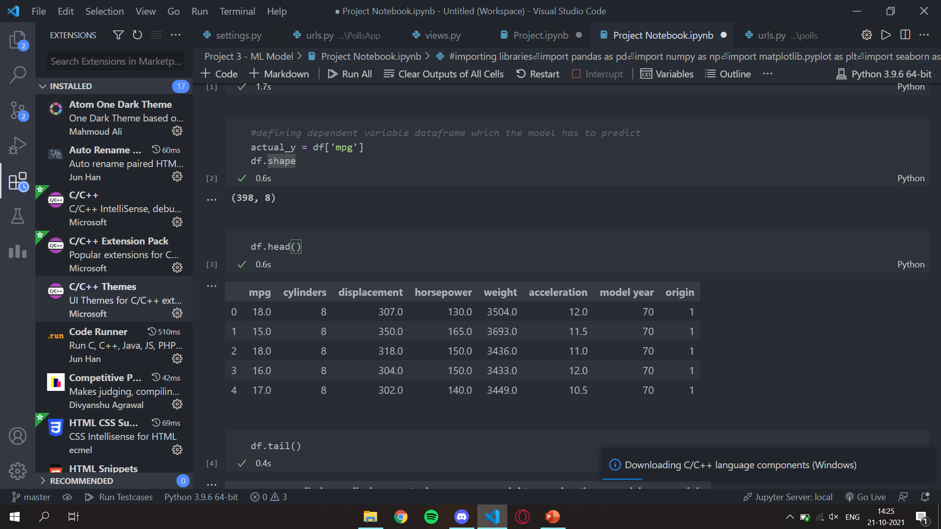
My Project

Slide 17
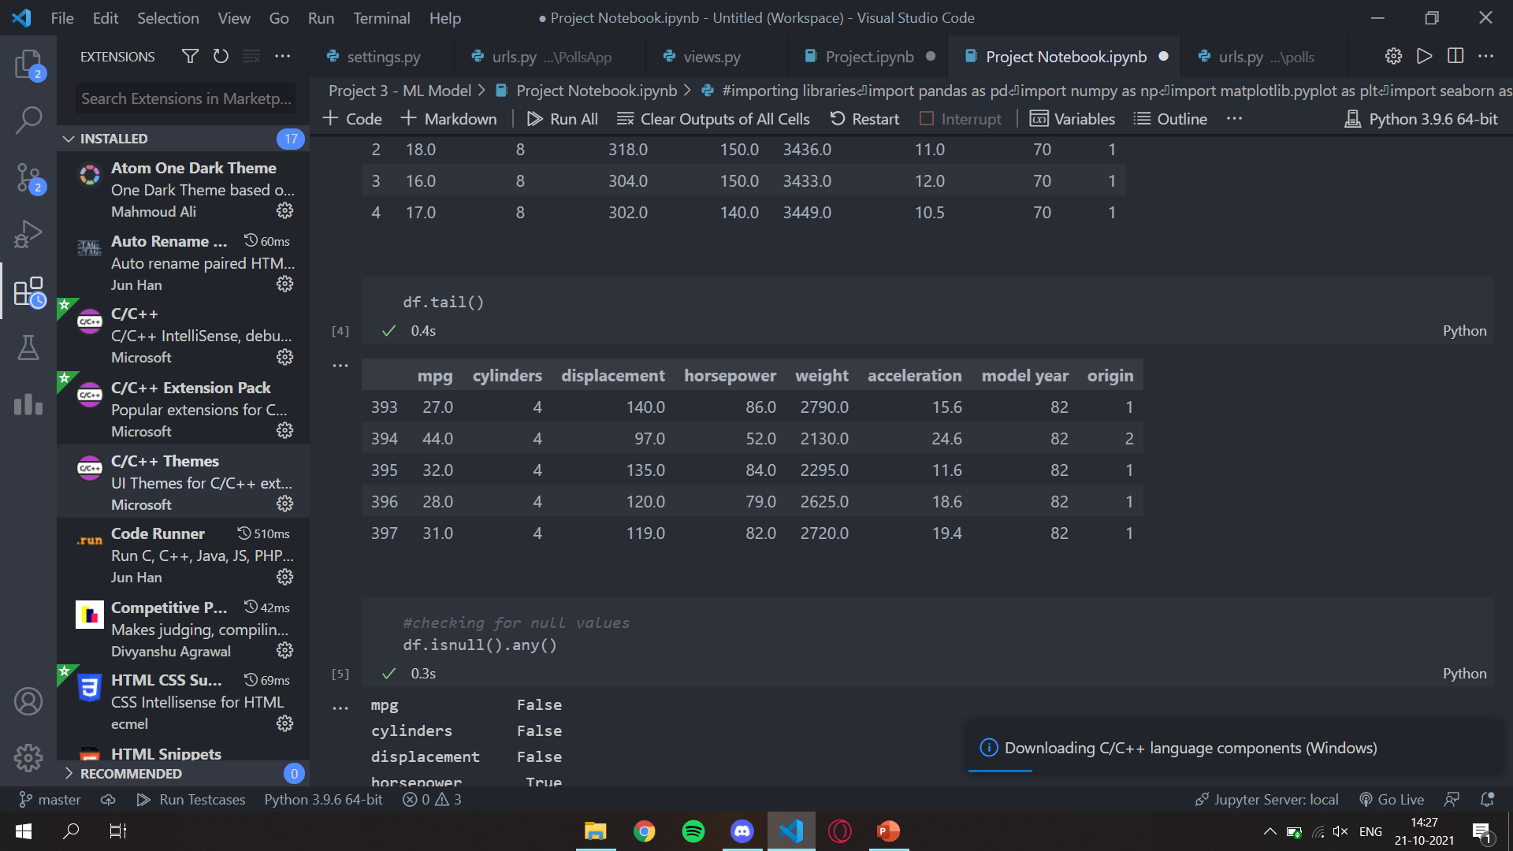
My Project

Slide 18
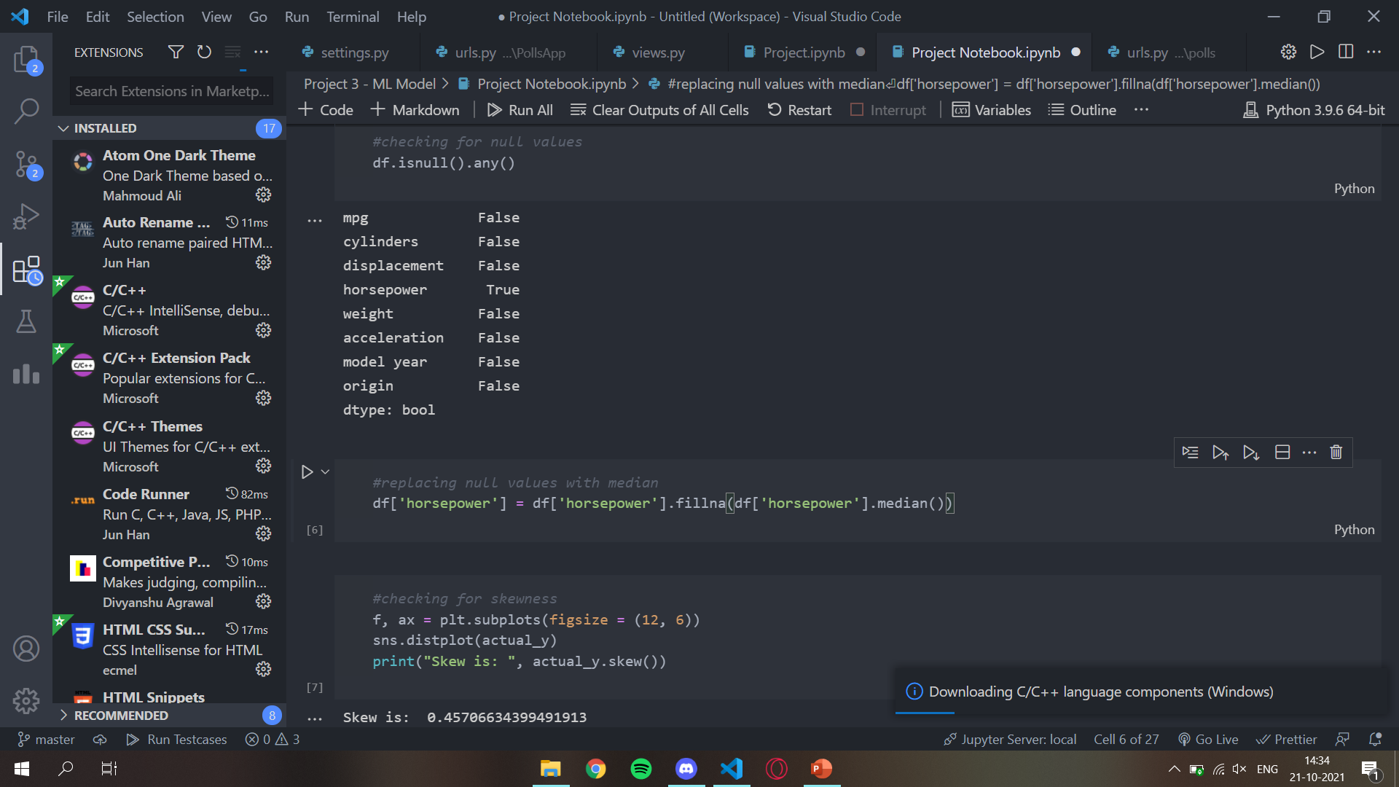
My Project

Slide 19
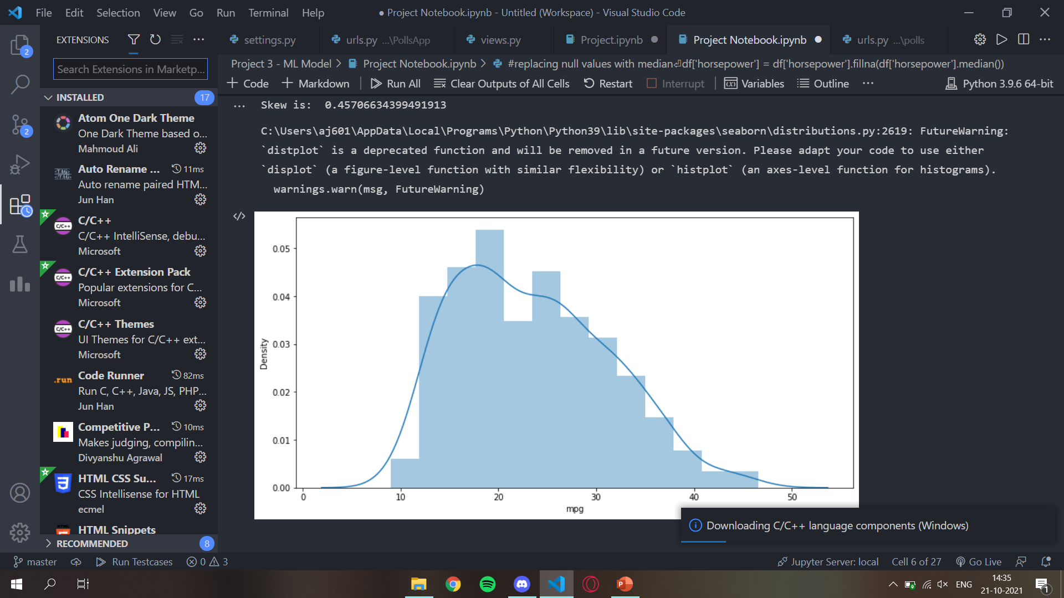
My Project

Slide 20
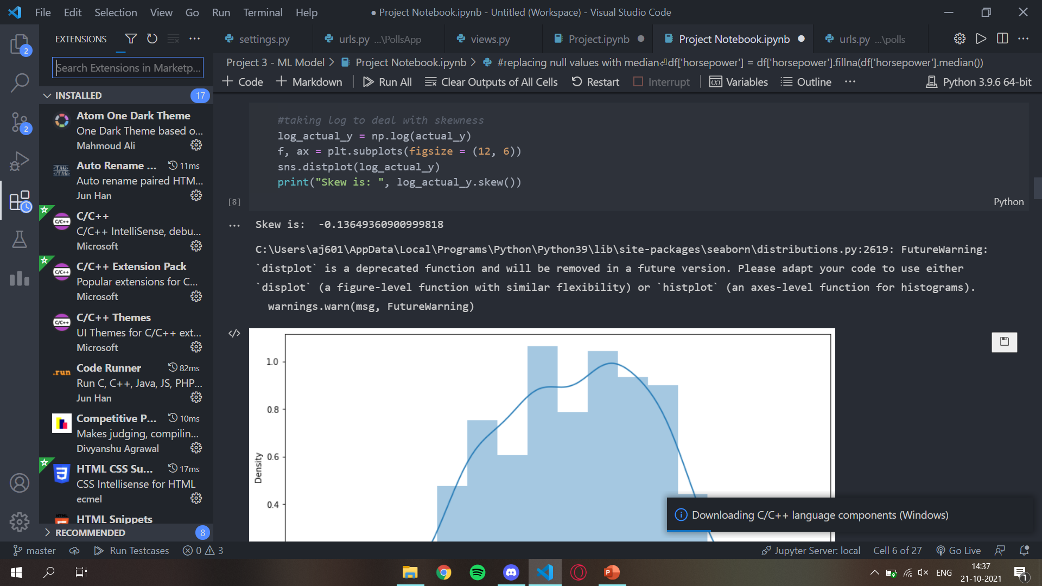
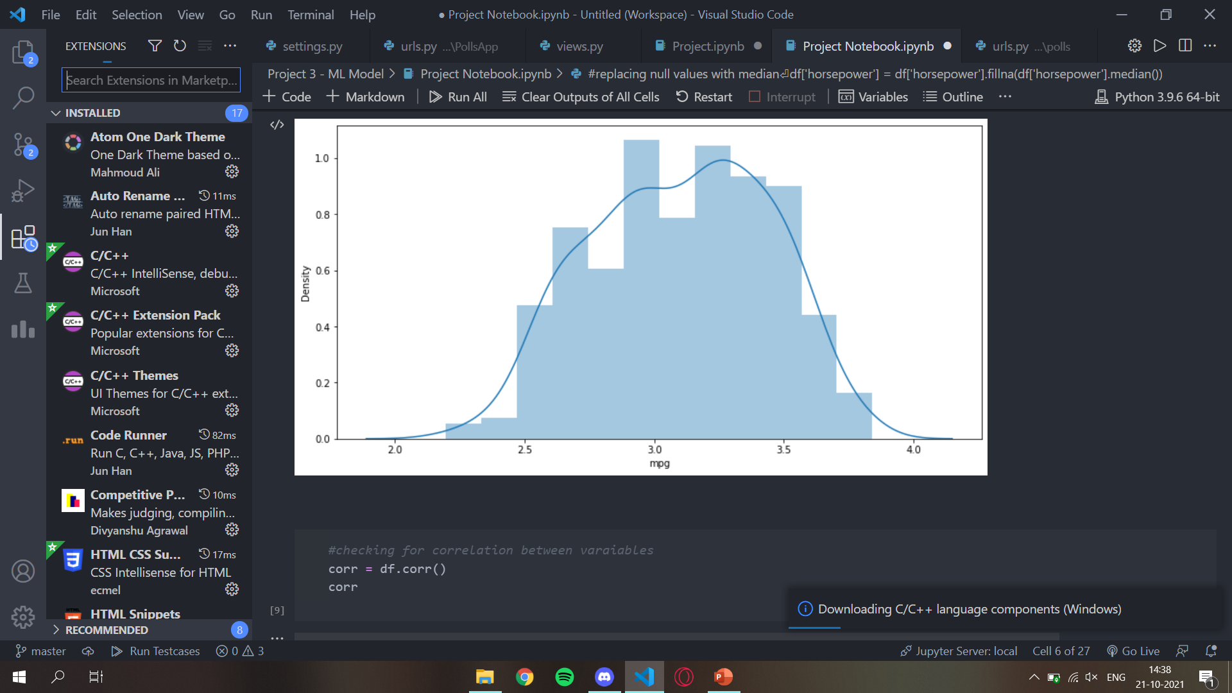
My Project

Slide 21
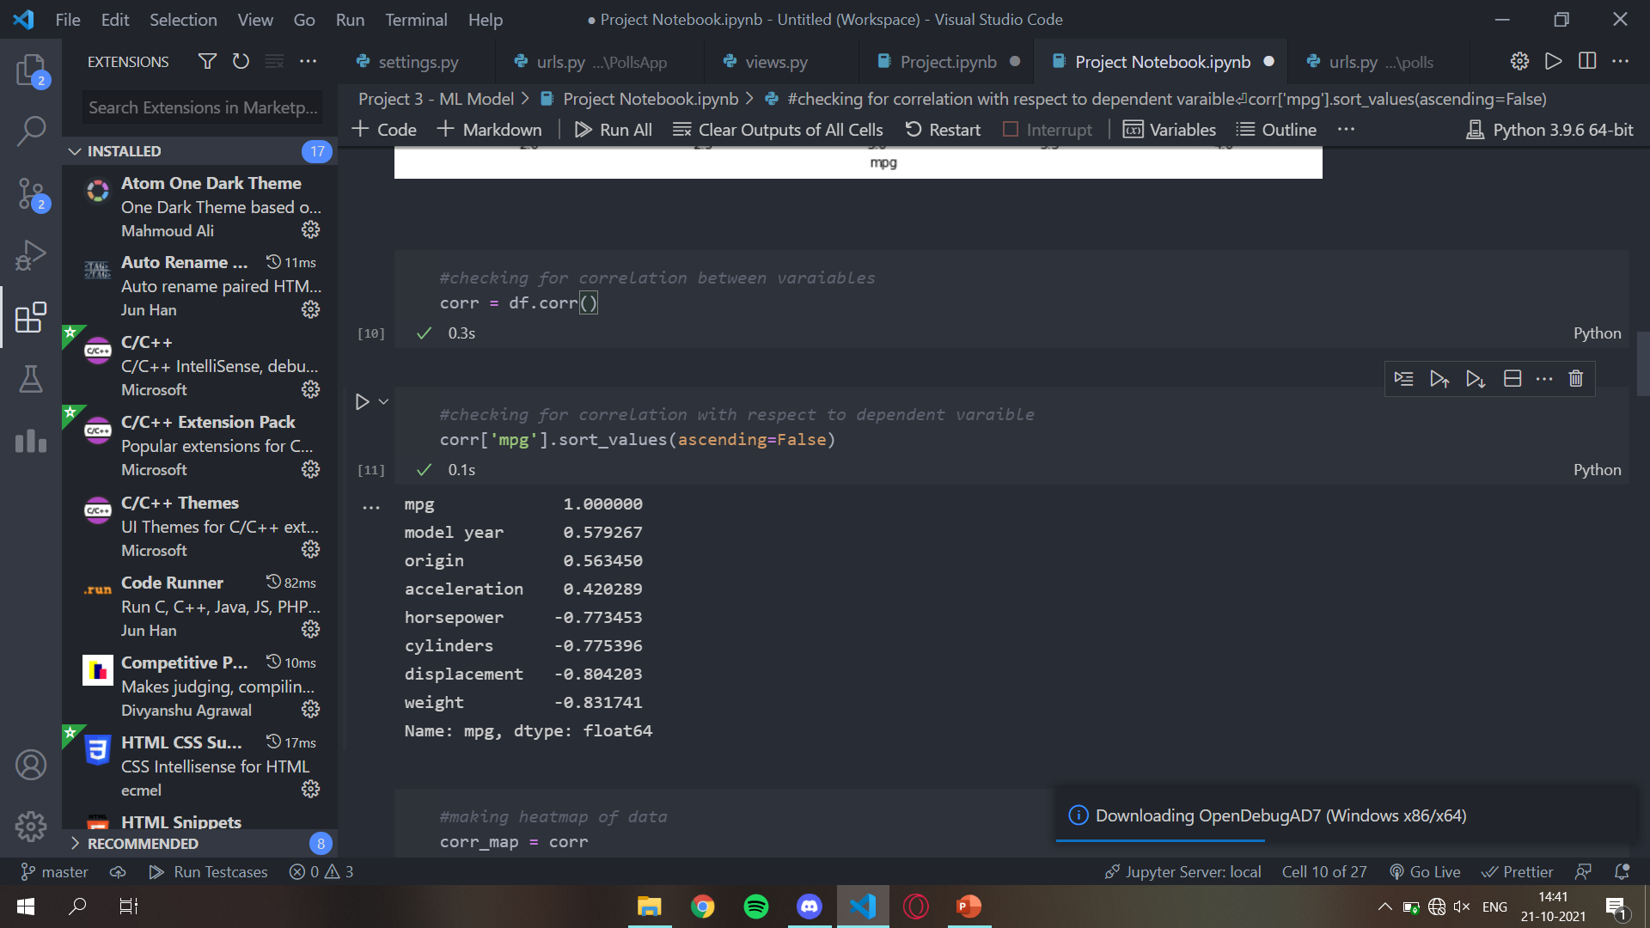
My Project

Slide 22
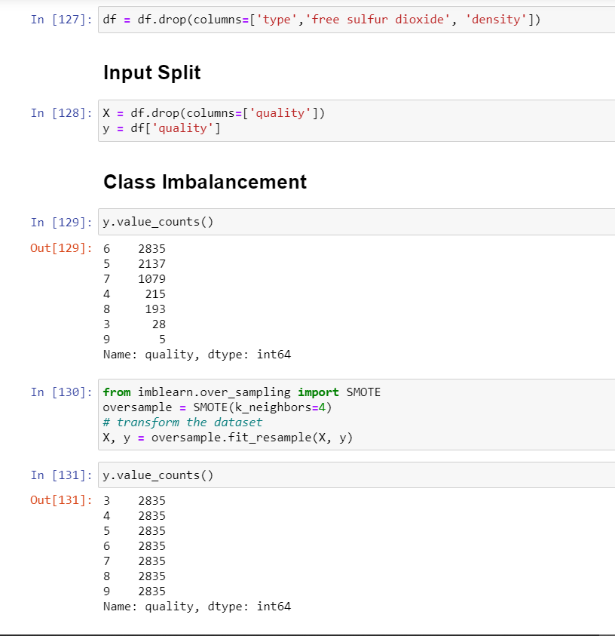
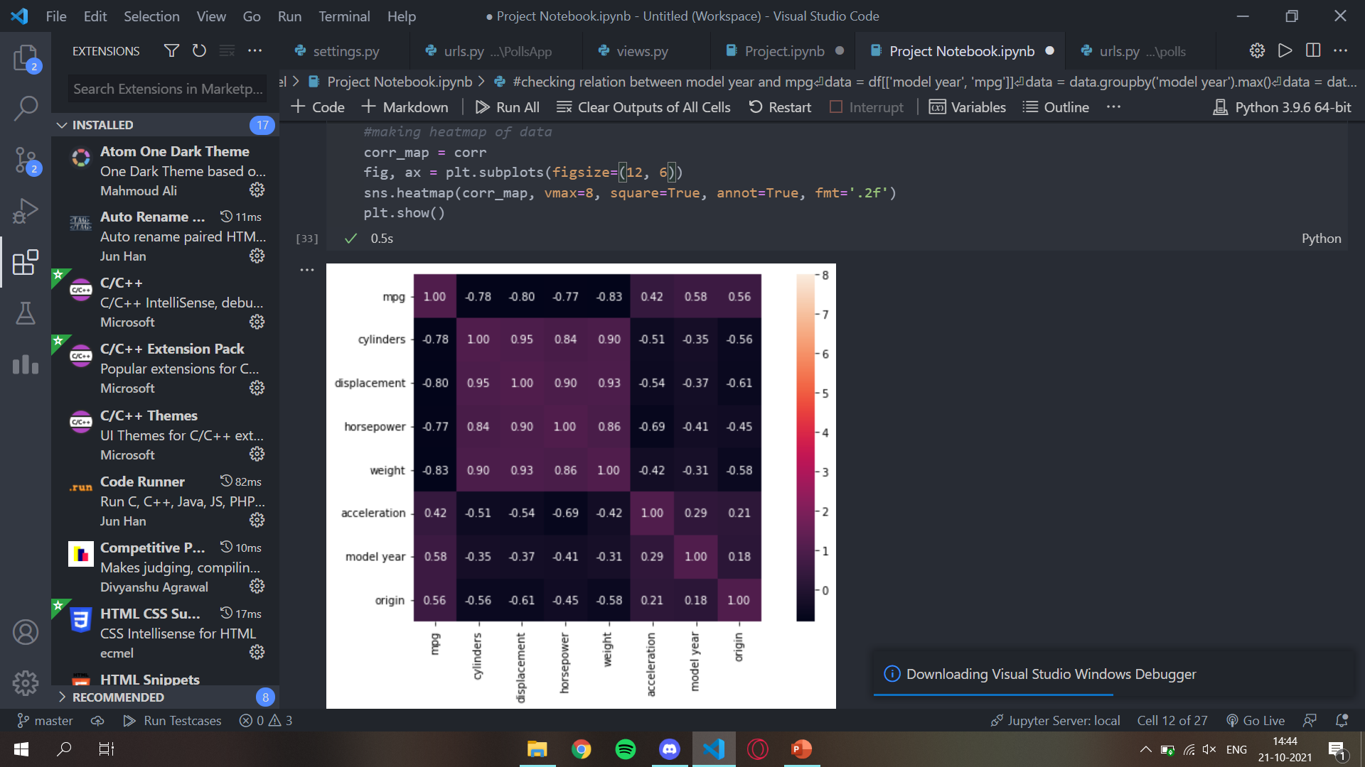
My Project

Slide 23
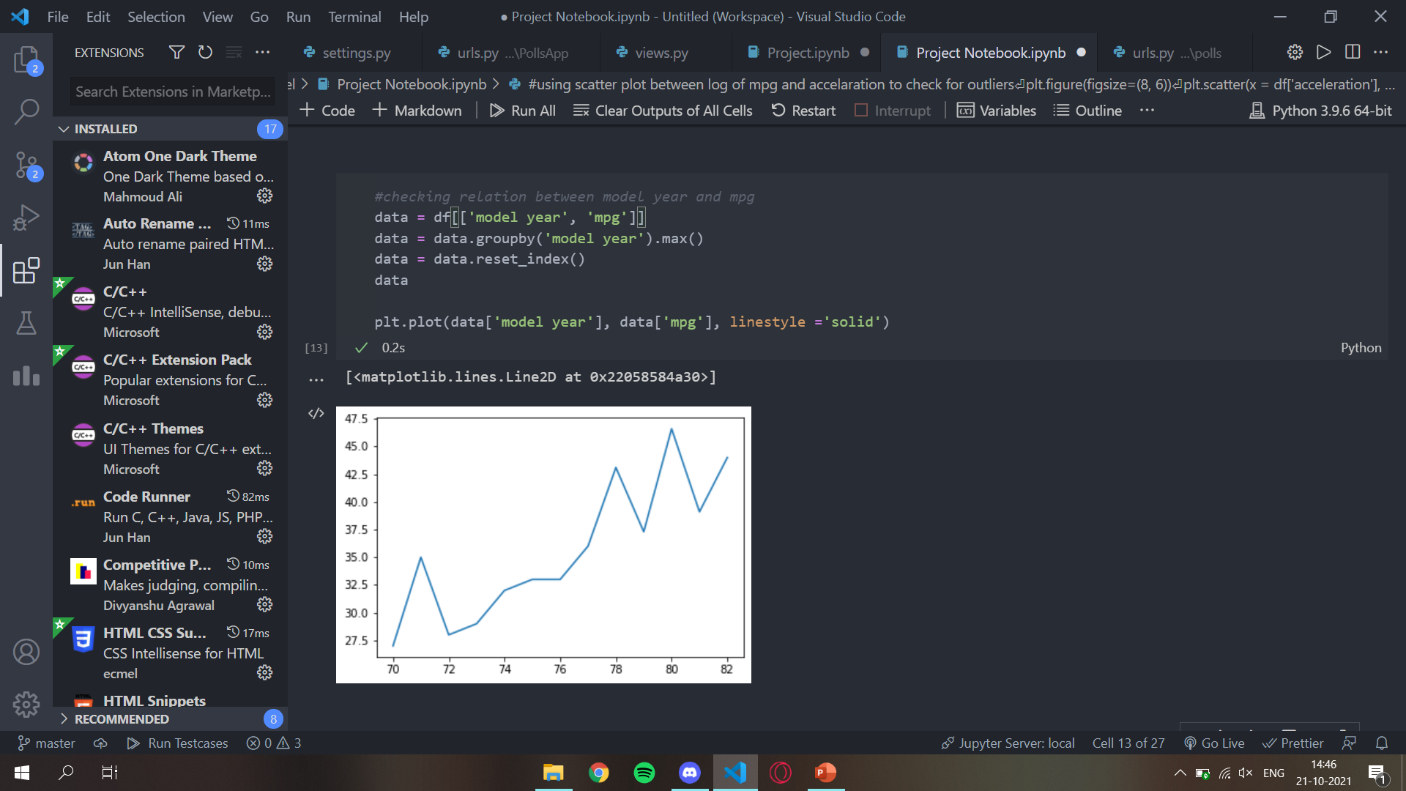
My Project

Slide 24
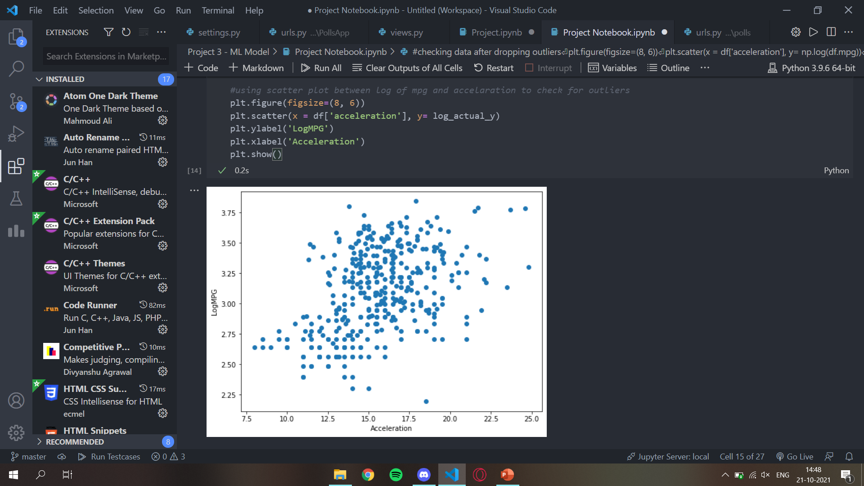
My Project

Slide 25
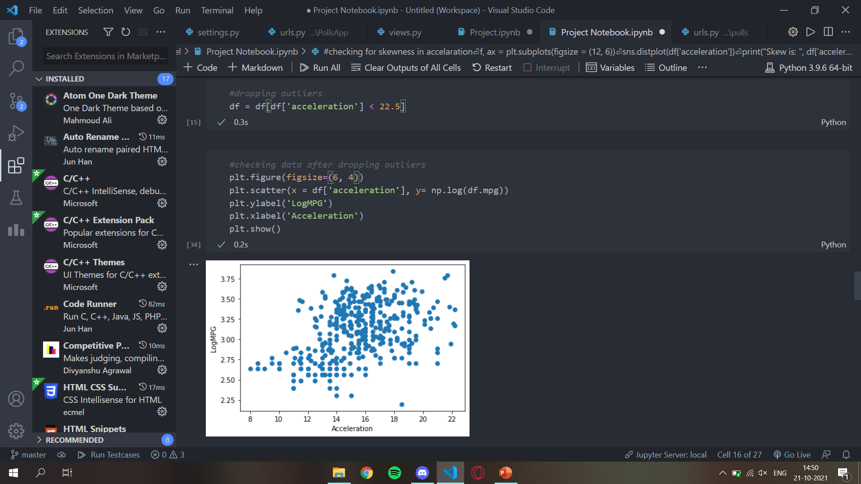
My Project

Slide 26
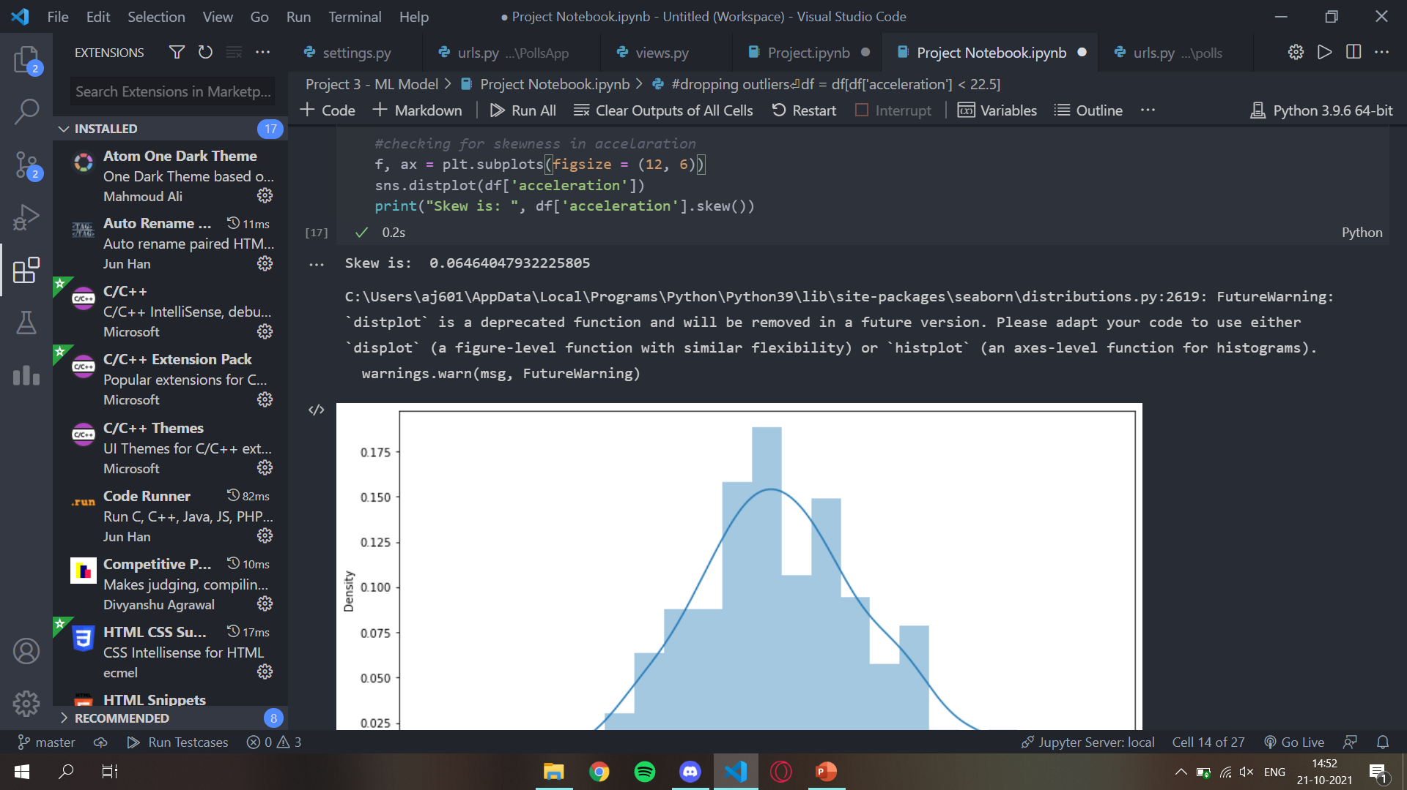
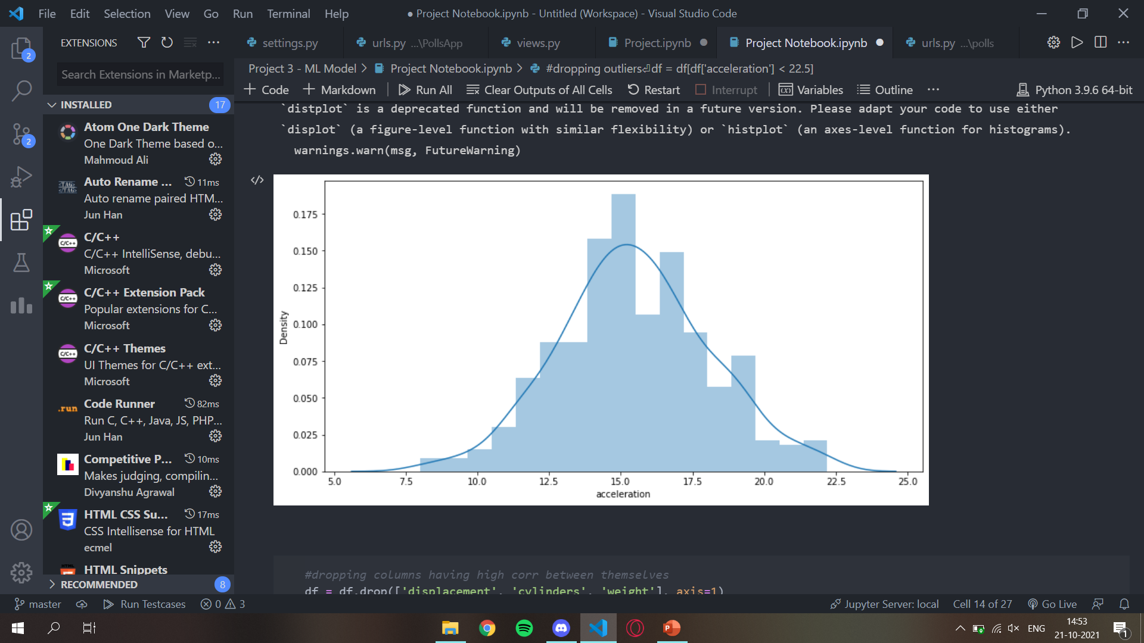
My Project

Slide 27
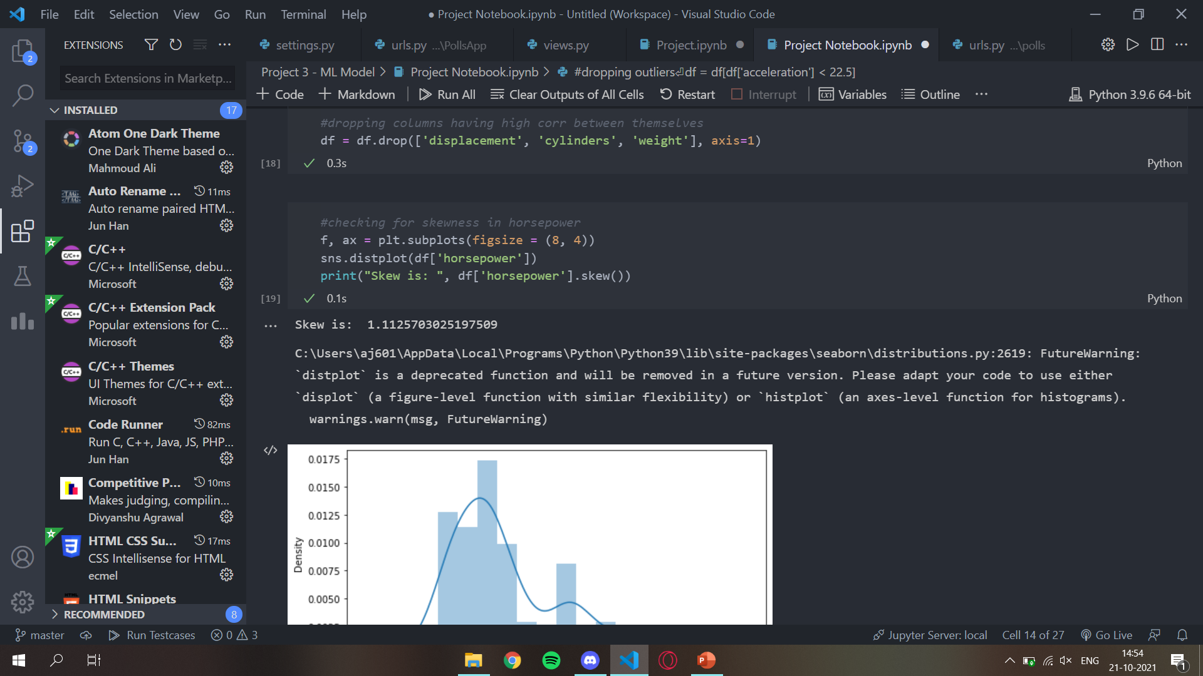
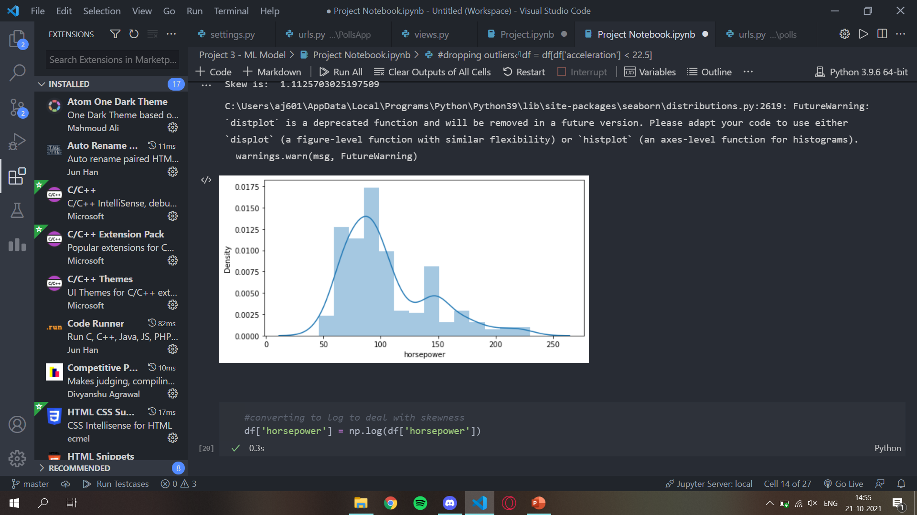
My Project

Slide 28
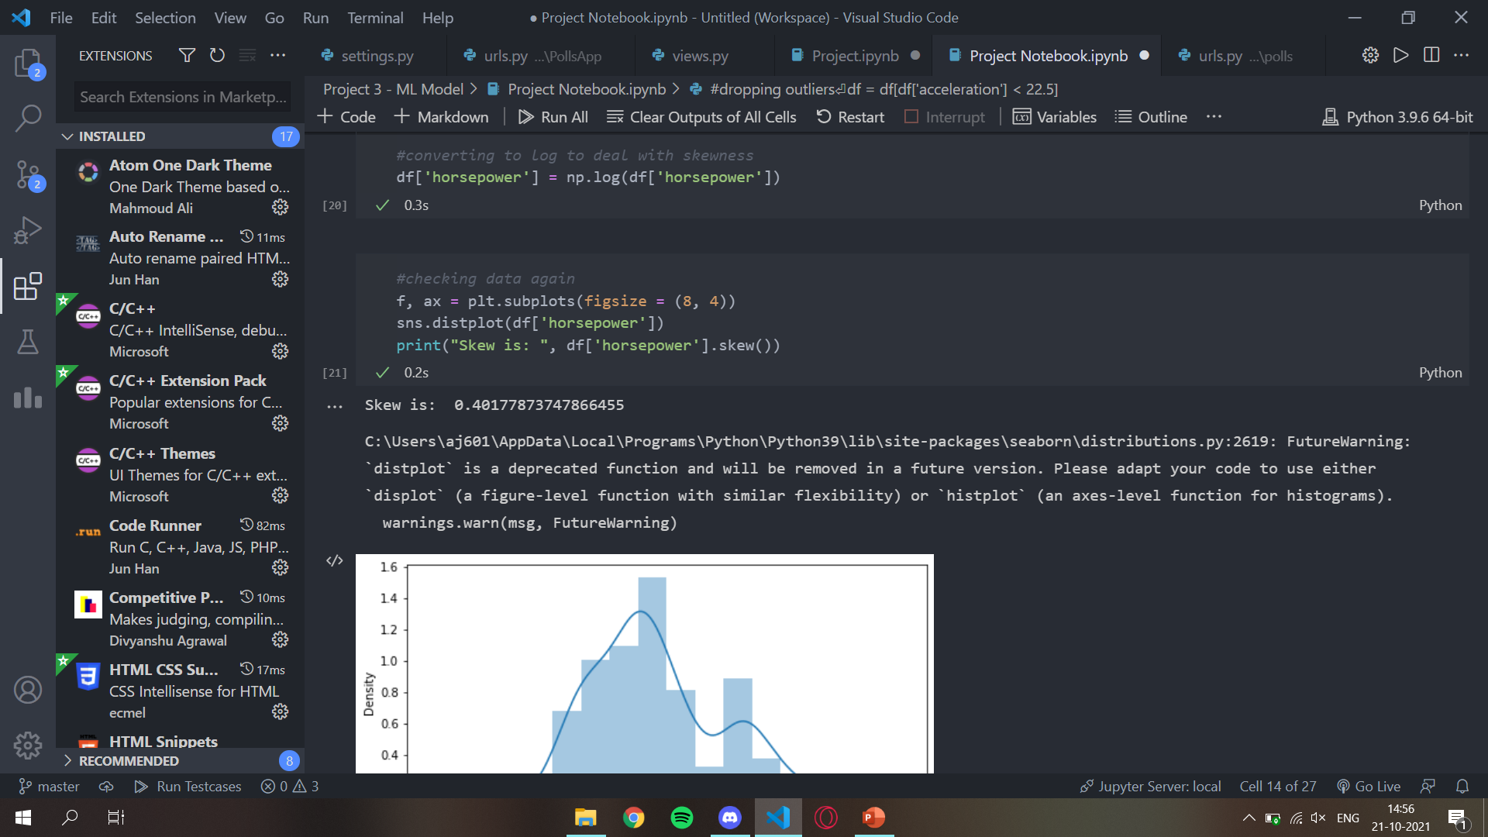
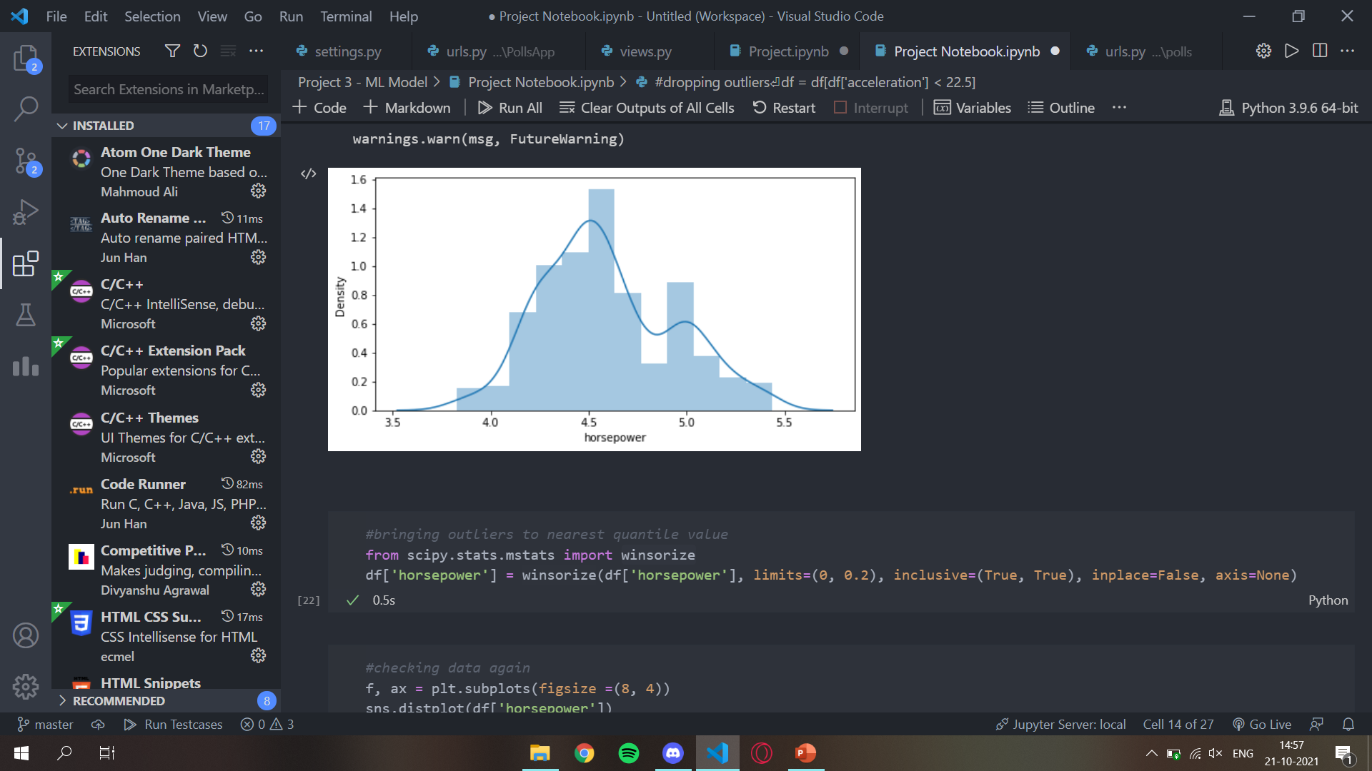
My Project

Slide 29
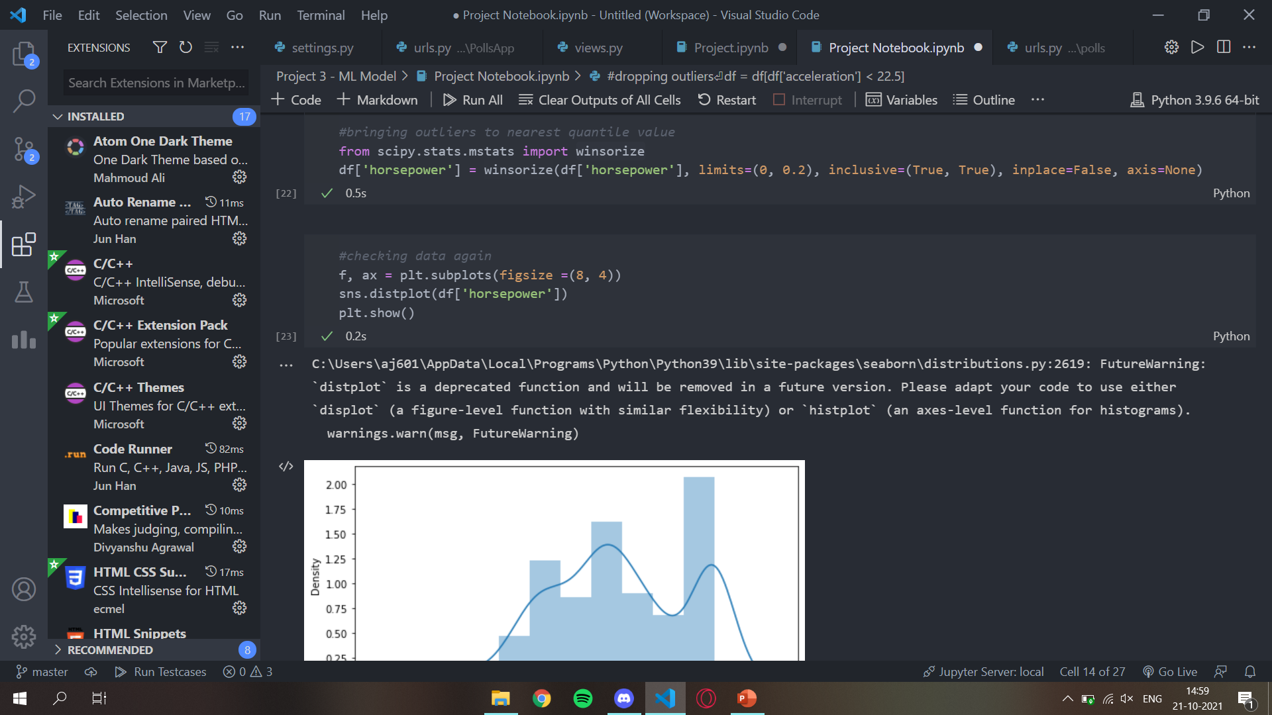
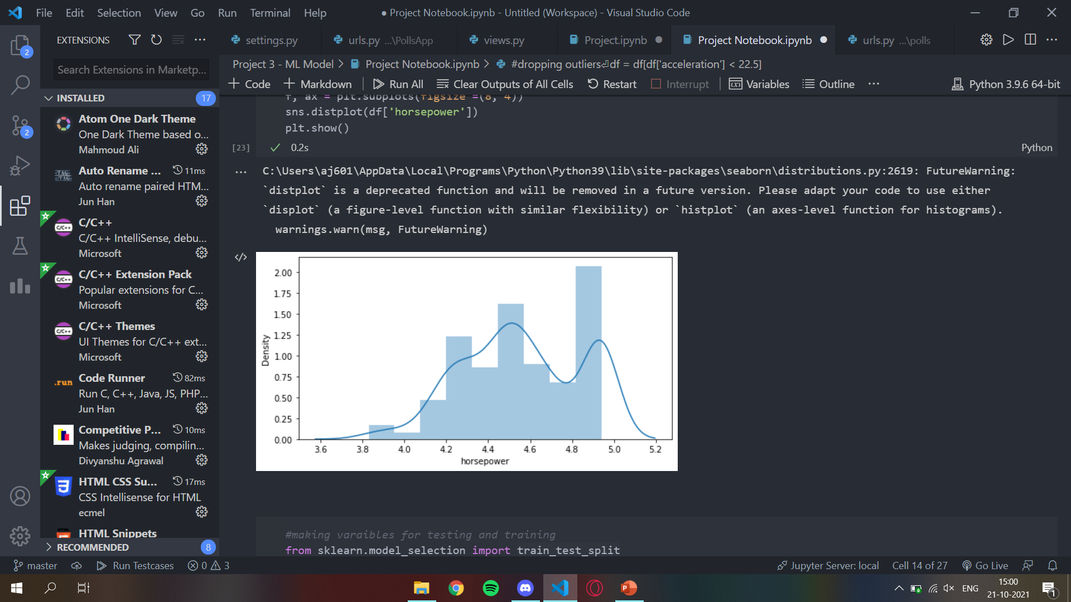
My Project

Slide 30

My Project

Slide 31

My Project

Slide 32
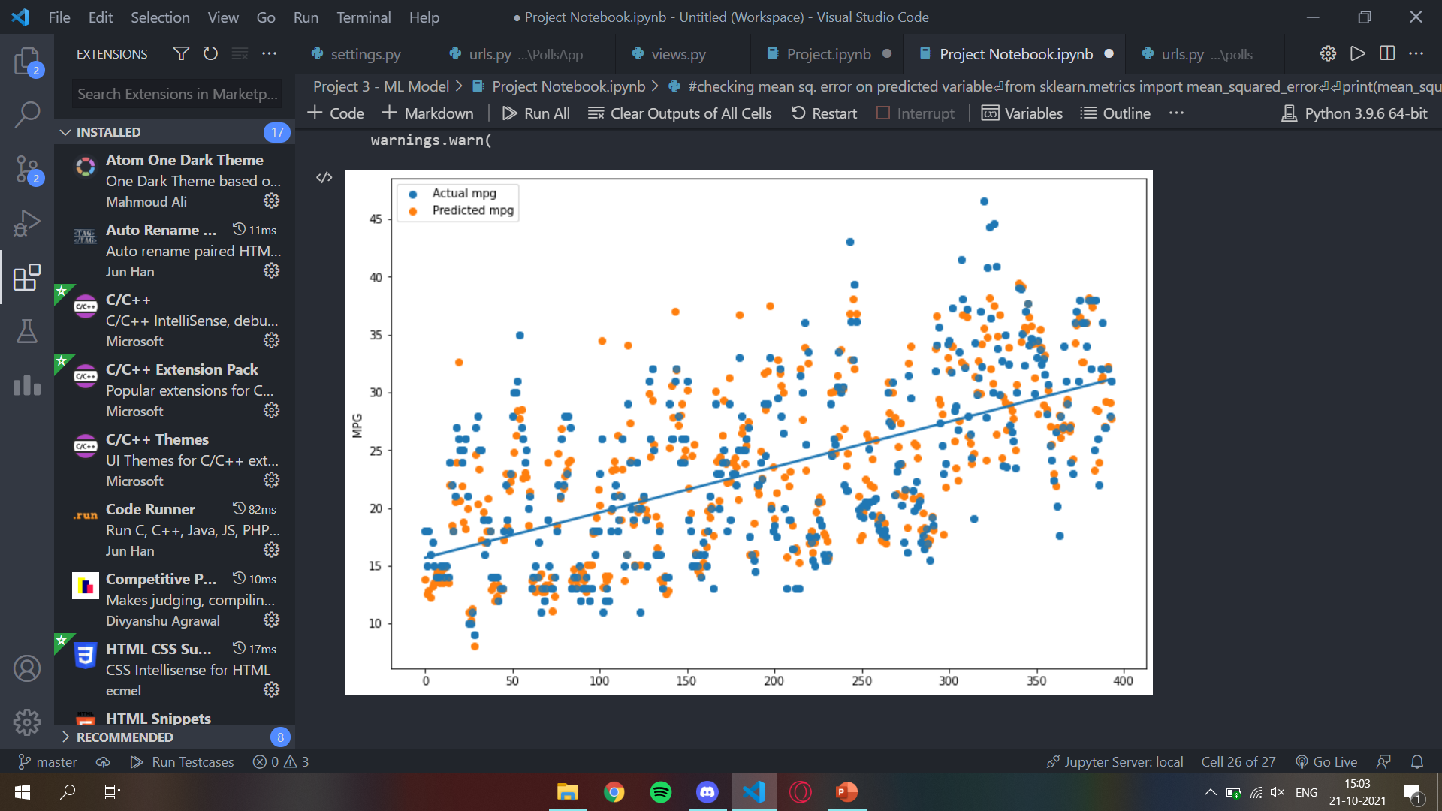
My Project

Slide 33
What it Does.
The project shown above analyses the dataset given to us. And then on the basis of training data received out of the complete data, the computer trains a model which predicts the output on the basis of training data received. Our project involves Data Preparation, Data Cleaning, EDA and Model Training. The better is the EDA of the data, better is the accuracy of the output received.
Our data was a Auto MPG Data and while working on the data we tried to achieve Linear Regression so that a line of fit could be found. We use Linear Regression Model and scatter plot to visualise the final output of the data and compare our predicted data with the actual data.

Slide 34
Conclusion
With the help of my demonstration project and this presentation, I would like to conclude by stating that, Machine learning domain has no limits and one can get a lot out from it if they know how to do it correctly. The main backbone of Machine Learning is a good DATA and a good analysis of the DATA. The Machine Learning field has been growing at an unbelievable rate for last 2 decades and best of it is yet to come.

Slide 35
Thank you
Ayush jain
2010051
Cse-1
2000270100058

